Slide 1
STOCK MARKET ANALYSIS
RAJHIV THIRUMAL YASHNA PARIKH RAVI EKAMBARAM

Slide 2
INTRODUCTION
Our project mainly focuses on analyzing the price variations of the stock of various companies provided by a Streaming API “RTstock” that extracts data with the following attributes on providing the name of the company as a parameter

Slide 3
OBJECTIVE
Main objective of our project is to build a predictor tool that would predict the stock prices based on the historic data.
The stock prices are predicted based on the previous day’s High, Low and Closing prices of a stock.
The Closing price is the most important variable to predict next day’s stock

Slide 4
ADVANTAGES
Stock market analysis like a 2 faced coins has both advantages and disadvantages. The current tools that predict the stock prices are just 30% accurate. If we could achieve more than that we would be the most successful amongst most of the companies. This would lead each company to take an educated guess on how efficiently to invest their money so that they would be profited most of the times.

Slide 5
Dataset
Stock prices of three companies(3M,Abbott Laboratories, AbbVie Inc.) collected over an year(Feb 2016 – Feb 2017)
The dataset contained the following attributes :
Adjclose
Volume
High
Low
Date
Close
Open
Company names

Slide 6
Data Preprocessing
To collect some biased data, we used a query to calculate which all companies have their stock values increased or risen on a given day.
if (stock['Close'] > stock['Open'])
Also, the stocks are classified as positive if its query is extended to check if the stocks collected are above $100 at the end of the given day and maximum difference in the value is greater than 2.
These queries are selected so that they can be used as the training set to approximately identify the value of the stocks for the following day. The close and open helps us to find out how big was the deviation for that day and how much has it risen on any given day can be calculated using the next query (high - low).

Slide 7
Classification
Classifier used :- k-Nearest Neighbors Classifier (k=5)
Future stock market closing price is computed by:
Determine the number of nearest neighbors, k.
Compute the distance between the training samples and the query record.
Sort all training records according to the distance values.
Use a majority vote for the class labels of k nearest neighbors, and assign it as a prediction value of the query record

Slide 8
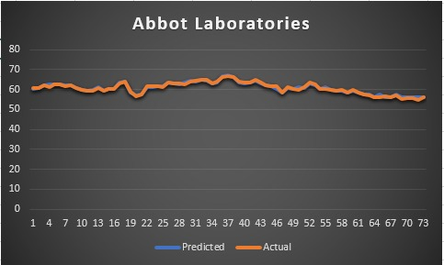
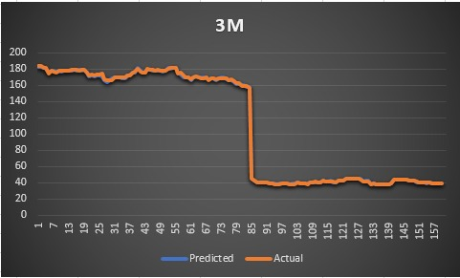
Result

Slide 9
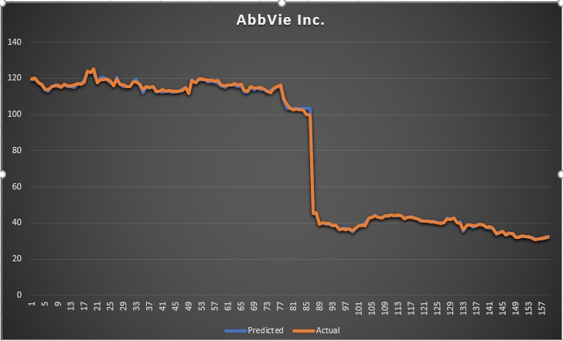
Result
Company | RMS(Root Mean Square)
3M | 0.708548
Abbot Laboratories | 0.507445
AbbVie Inc. | 0.723187

Slide 10
Challenges Faced
Since we are using the “RTstock APi” there are chances that we won’t be able to get enough data. (The data would be limited to the data available on “RTstock APi”).
The above API does not give any information about the external factors affecting the prices, that’s going to be a downfall for our prediction but we are not expecting a major one.
The influence that the previous values may have on the prediction for a few companies may be erratic which would be hard to tackle.

Slide 11
Future Work
Our current prediction is based entirely on historic stock prices
Stock prices are affected by various other factors like different economic factors, political stability and other unforeseeable circumstances.
We have planned to retrieve some news about that company on that given date and analyze the sentiment and try predicting the stock of that company

Slide 12
QUESTIONS?

Slide 13
THANK YOU

